Slide 1
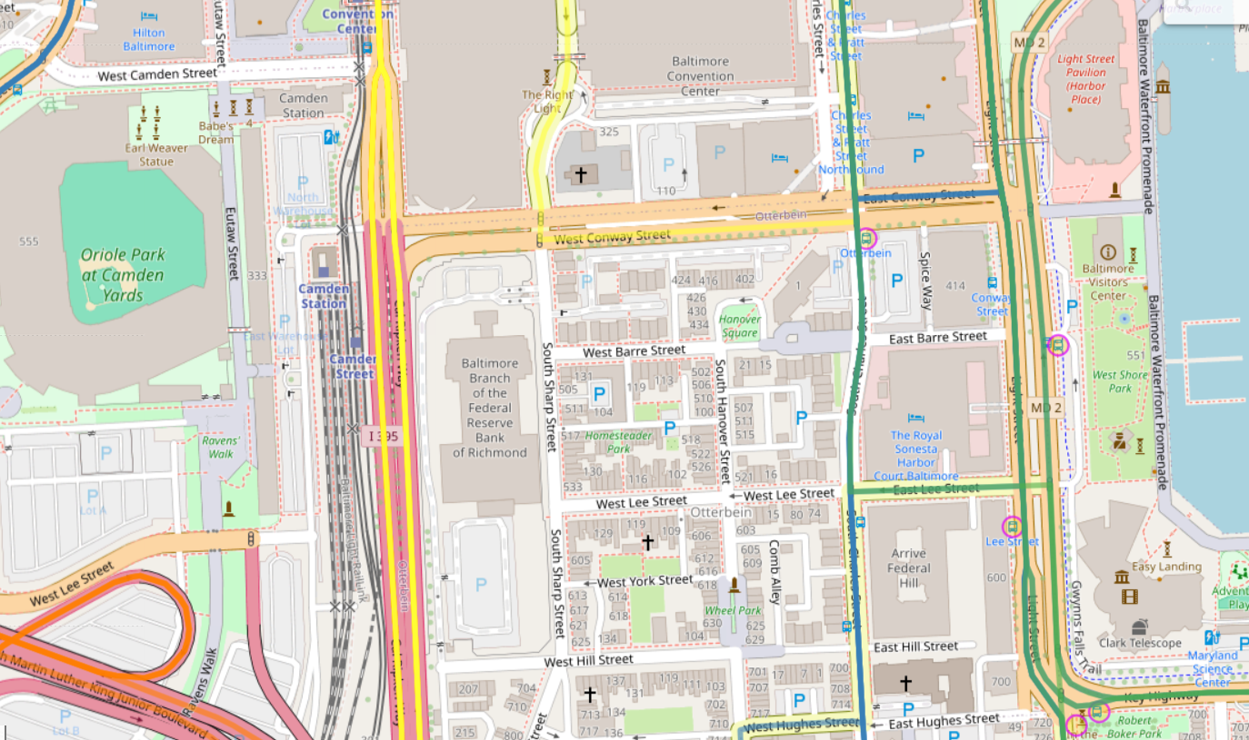
35042
51612
63030
5210
5135
8905
4004

Slide 2
35042
[5135,8905,5210]
[5210,51612]
51612
[5135,8905]
63030
5210
5135
8905
4004
[5135,8905]
[5135,8905]
[8905,5210]
[8905,5210]
[5210,51612]

Slide 3
35042
6416
28366
51612
7020
63030
5210
5135
8905
4004
7020
7020
7057
7057
28366

Slide 4
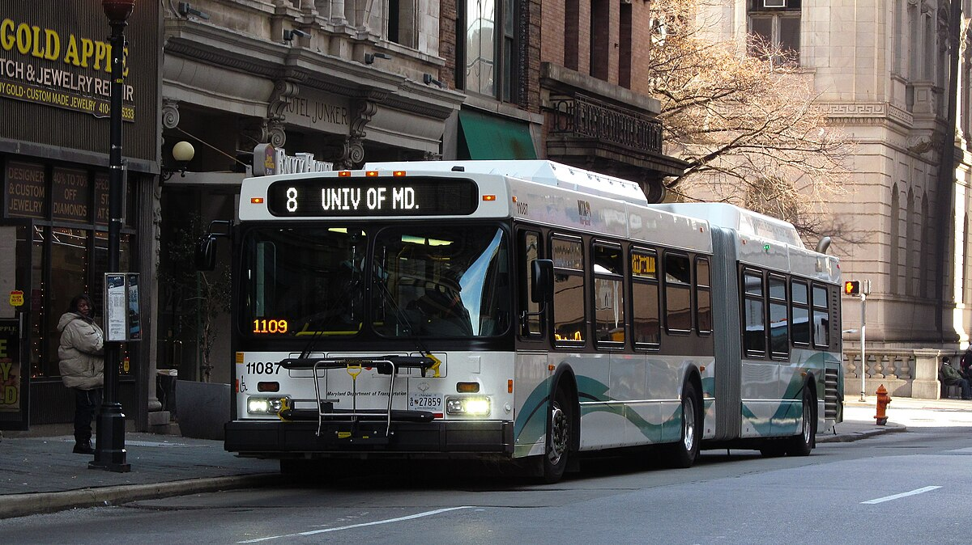
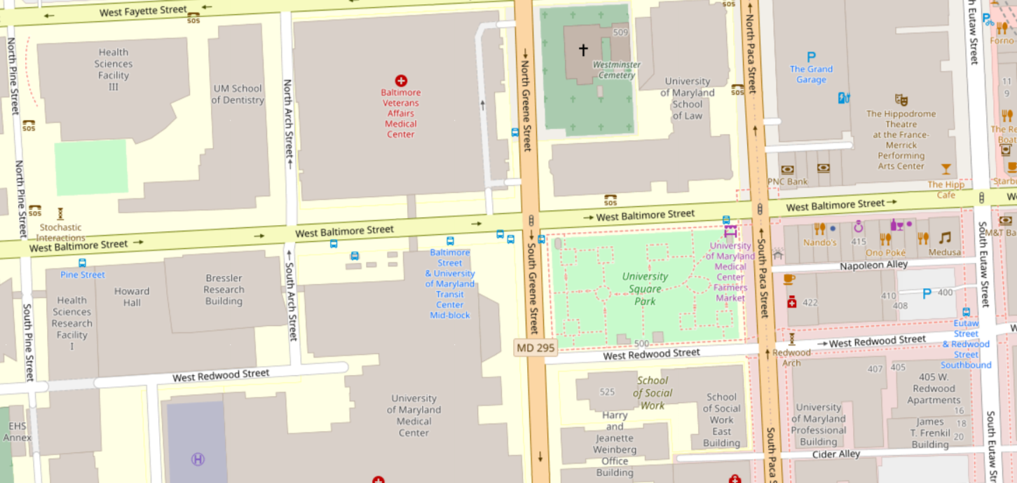
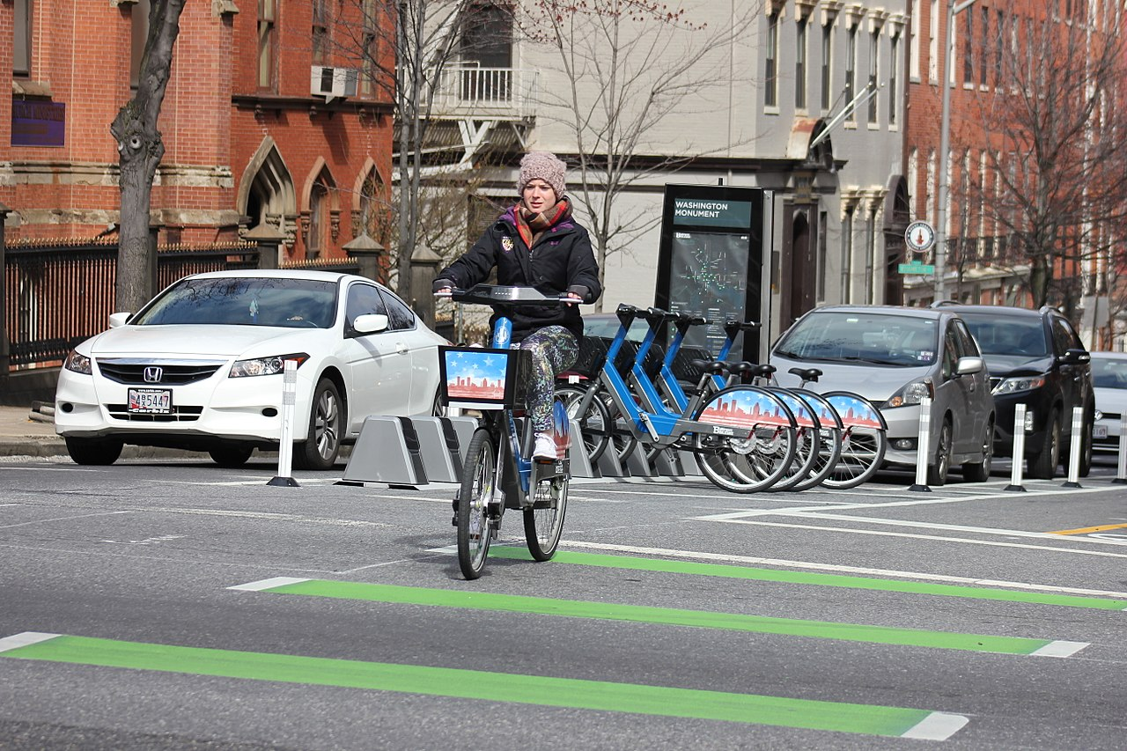
BaltimoreLink and Baltimore Bike Share

